Slide 1

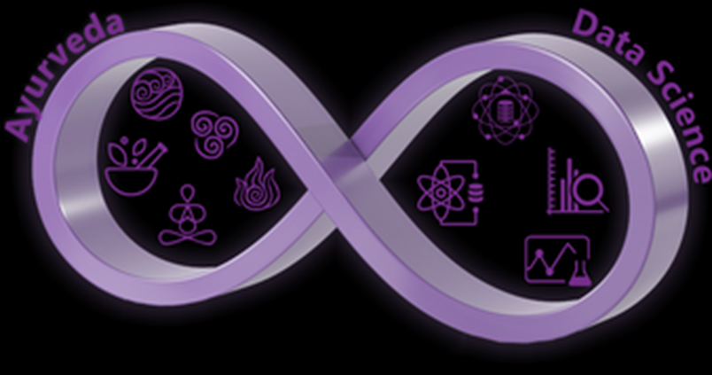
Tongue image analysis using deep learning in Ayurveda Wellbeing Applications. Worked on this project with Atreya Innovations for 6 months
Sayali Salunkhe (CMS1828)
Internal guide
-Dr. BhalchandrA Gore
(Assistant professor - SCMS)
EXTERNAL GUIDE
-Dr. Aniruddha Joshi
( Founder, atreya innovations)

Slide 2
Content
Objective
Introduction :
Ayurveda
Tongue Analysis
Tongue Image Segmentation
Data collection and Pre-processing : COCO dataset
Modelling :
Why Detectron2
Implementation
Evaluation
Results
Conclusion & Future Scope

Slide 3
Project Objective and Introduction
We are exploring how convolutional neural networks (CNNs) can learn abstract concepts by analyzing tongue images based on concepts from Ayurveda, which is a discipline that relies heavily on practitioner experience.
Tongue diagnosis is an important way of monitoring human health status in Ayurveda.
Even GP’s observe tongue in their diagnosis process.
Automatic Tongue diagnosis should include detection of tongue outline, cracks, whiteness coating
This will help the doctors in the computer-aided diagnosis
It involves performing image segmentation for tongue image processing.
Notes:
Similar ECG , BP machines we are developing tongue based computer system.

Slide 4
Project Objective and Introduction
To learn and implement object detection ( a significant concept in deep learning and image processing.)
Application 1 – pedestrian detection
Application 2 - medical MRI image analysis for cancer detection
To perform different techniques of deep learning like convolutional neural networks and other region proposal-based models
Hypothesis: It will increase the performance of object detection task.
To develop a home-based, non-invasive, personalised , predictive API tool for automatic tongue image diagnosis using Ayurveda science.
Notes:
1. Object detection is a significant concept in deep learning and image processing that deals with detection of objects in images and real-time videos.
2. By performing different techniques of deep learning like convolutional neural networks and other region proposal based models the performance of object detection task became more accurate
3. In this project, we are doing performance analysis of the object detection on tongue images using Facebook AI research object detection library named Detectron2.
Significant contribution : Company is going to use this tool in their product TURYAA wellness

Slide 5
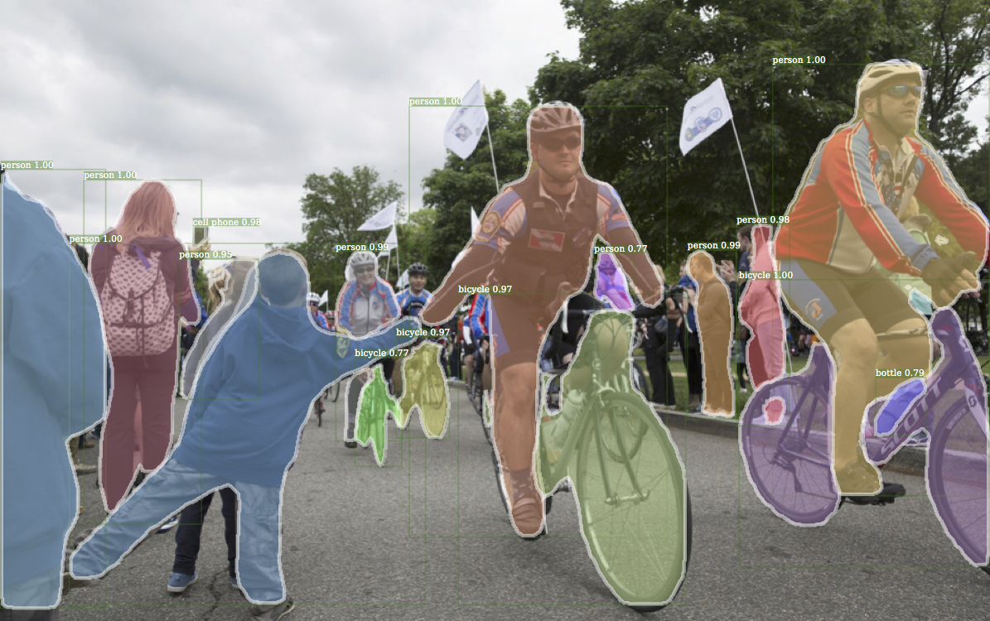
Project Objective and Introduction
We propose a novel end-to-end model experimenting with state-of-the-art architecture i.e., Detectron2 (Facebook AI Research model) for learning tongue localization and segmentation.
In this model pixel-level prior information is utilized for supervised training of the deep convolutional neural network.

Slide 6
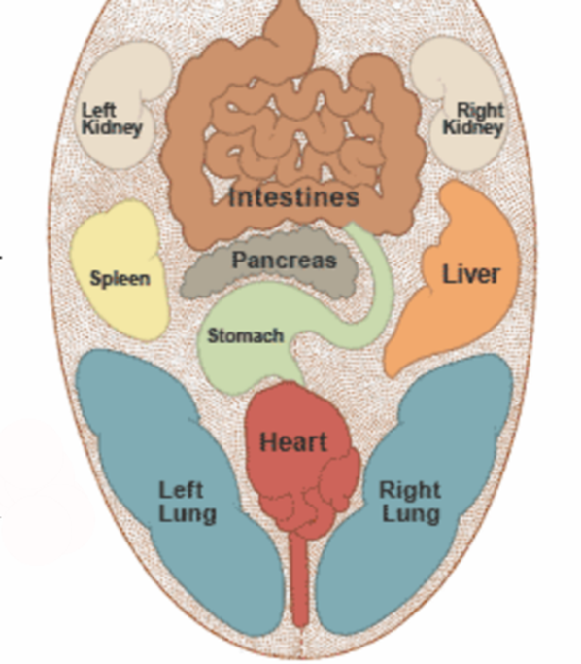
Tongue-based analysis in Ayurveda:
Tongue localization - Divide image into segments.
Tongue analysis :
Clinical analysis of tongue is performed to make it possible to interpret what is happening in entire body through a square inch of tongue.
To interpret tongue signs, practitioner requires insight.
Similarly, Artificial Intelligence can learn some concepts by analyzing sensory data like humans.

Slide 7
Image Segmentation :
Segmentation : Split or separate an image into regions
To facilitate recognition, understanding and region of interest (ROI) processing.
Two kinds of approaches to segmentation : discontinuity and similarity
Region based segmentation is based on the connectivity of similar pixels in a region.
1) Each region must be uniform
2) Connectivity of pixels within the region is very important.

Slide 8
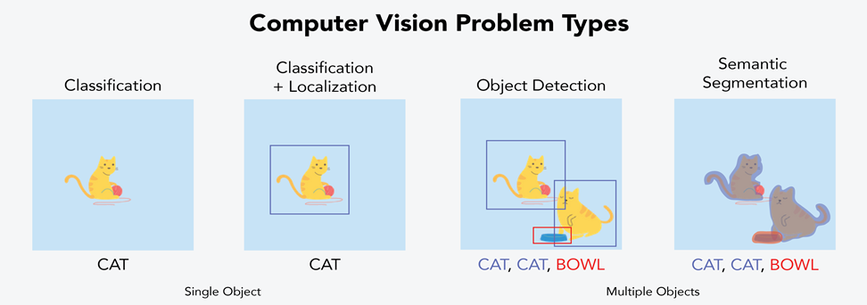
Semantic segmentation:
Object detection led to semantic segmentation
Silhouette

Slide 9
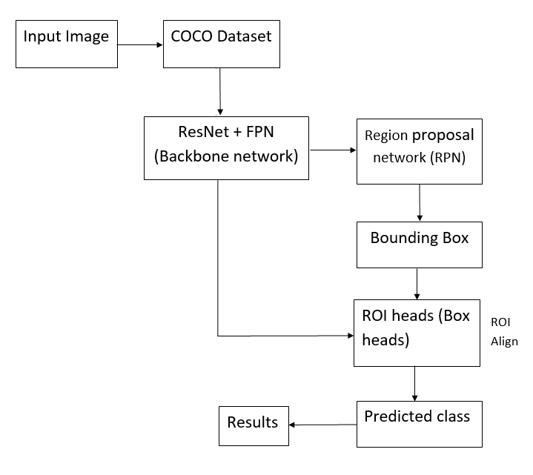
Proposed methodology: Detectron2
Detectron2 is combination of multiple techniques that perform different functionality such as box, mask, keypoint, densepose etc.
RCNN: It just provides box.
Mask-RCNN (Region- Convolutional Neural Network): It provides silhouette which is solid shape of single colour, with its edges matching the outline of the subject.
Important python libraries used are pandas, NumPy , OpenCV framework
Google Collaboratory for training purpose
Block diagram of proposed methodology

Slide 10
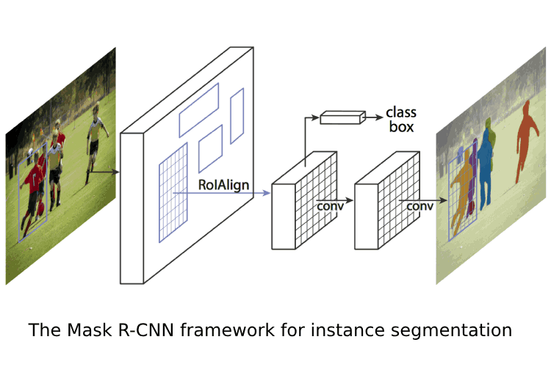
Mask R-CNN:
Reference:MaskRCNN

Slide 11
History of Detectron2 :
Network Type | Features | Framework
RCNN – Region Based convolutional neural network | The is idea that we would only look for objects in regions which have high probability of having some objects. Basically, region proposals are created & then neural network would detect objects within them. It provided boxes as shown in 2nd box. | caffe release was made in 2015
Mask - RCNN | It provides silhouette (which is solid shape of single color, with its edges matching the outline of the subject). Silhouette or Mask gives us the object location. | TensorFlow and Keras was used to create this neural network.
Detectron | It has backbone-based architecture. Backbone generates its region proposals & which are further optimized using machine learning. | It is written in Python and powered by the Caffe2 deep learning framework.
Detectron2 | Detectron2 is based on Detectron, but it is much more powerful and works at very high speeds. It is combination of multiple techniques that perform different functionality. | It has Pytorch release in 2019.

Slide 12
The Lola app:
Lola app combines technology with traditional Ayurveda by using AI approach to find out your health condition through a simple test by taking a tongue picture. This application was developed by Atreya in beta version.
This app analyzed the dryness, crack, and whiteness in tongue which in turn help us understand the health condition of the person taking the tongue test.
This health app is the first of its kind that works on the tongue analysis, using image processing technology to detect the health status of users and provide the health score and recommendations accordingly.
This test is an exceptional way not only to monitor health but also take preventive measures to live a healthy life based on our diet and lifestyle recommendations specifically designed for individual depending on health condition.
Link for Lola app
Notes:
Few of processes in Lola app were manual. So Atreya company hired me to convert them into automation.

Slide 13
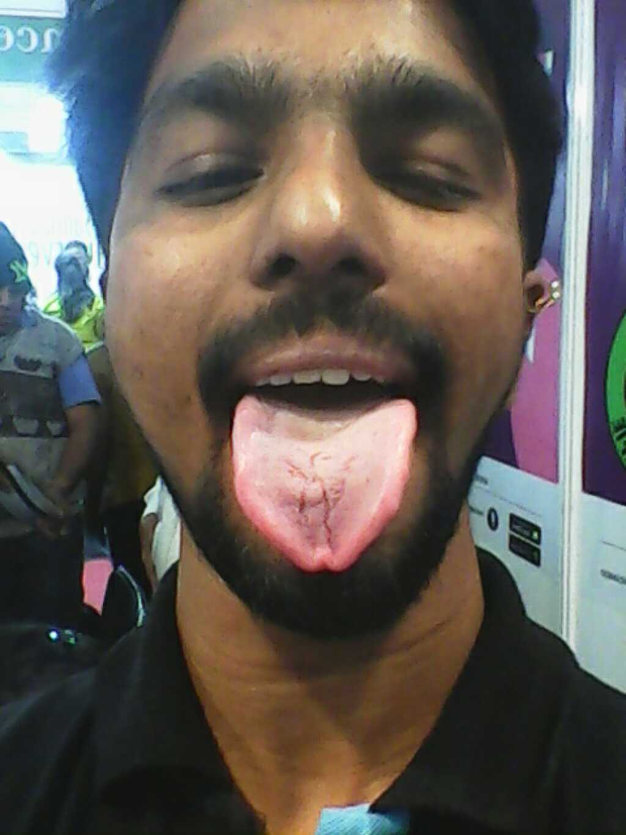
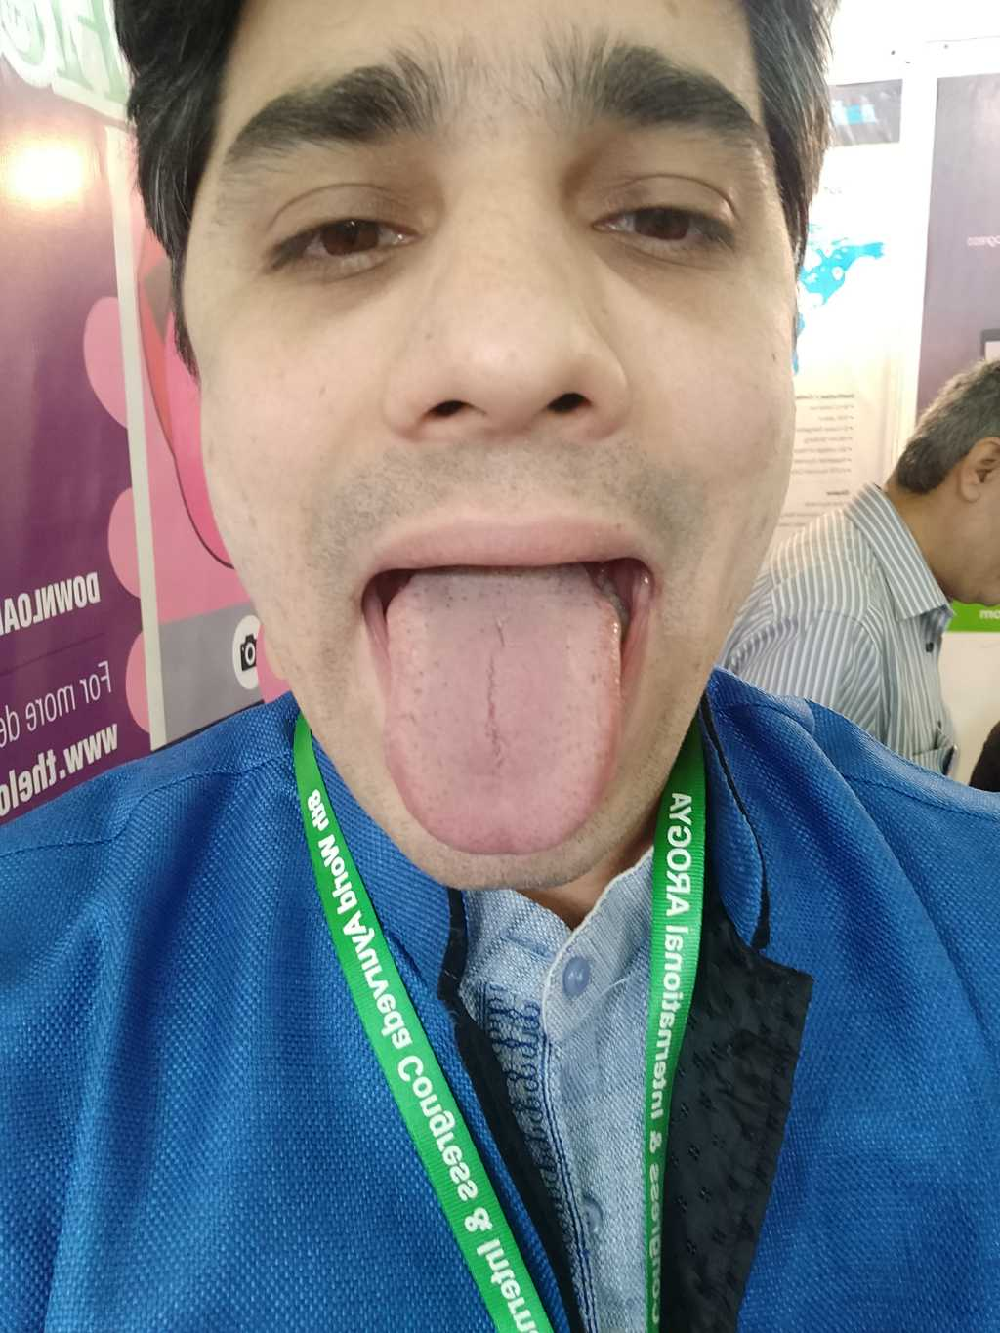
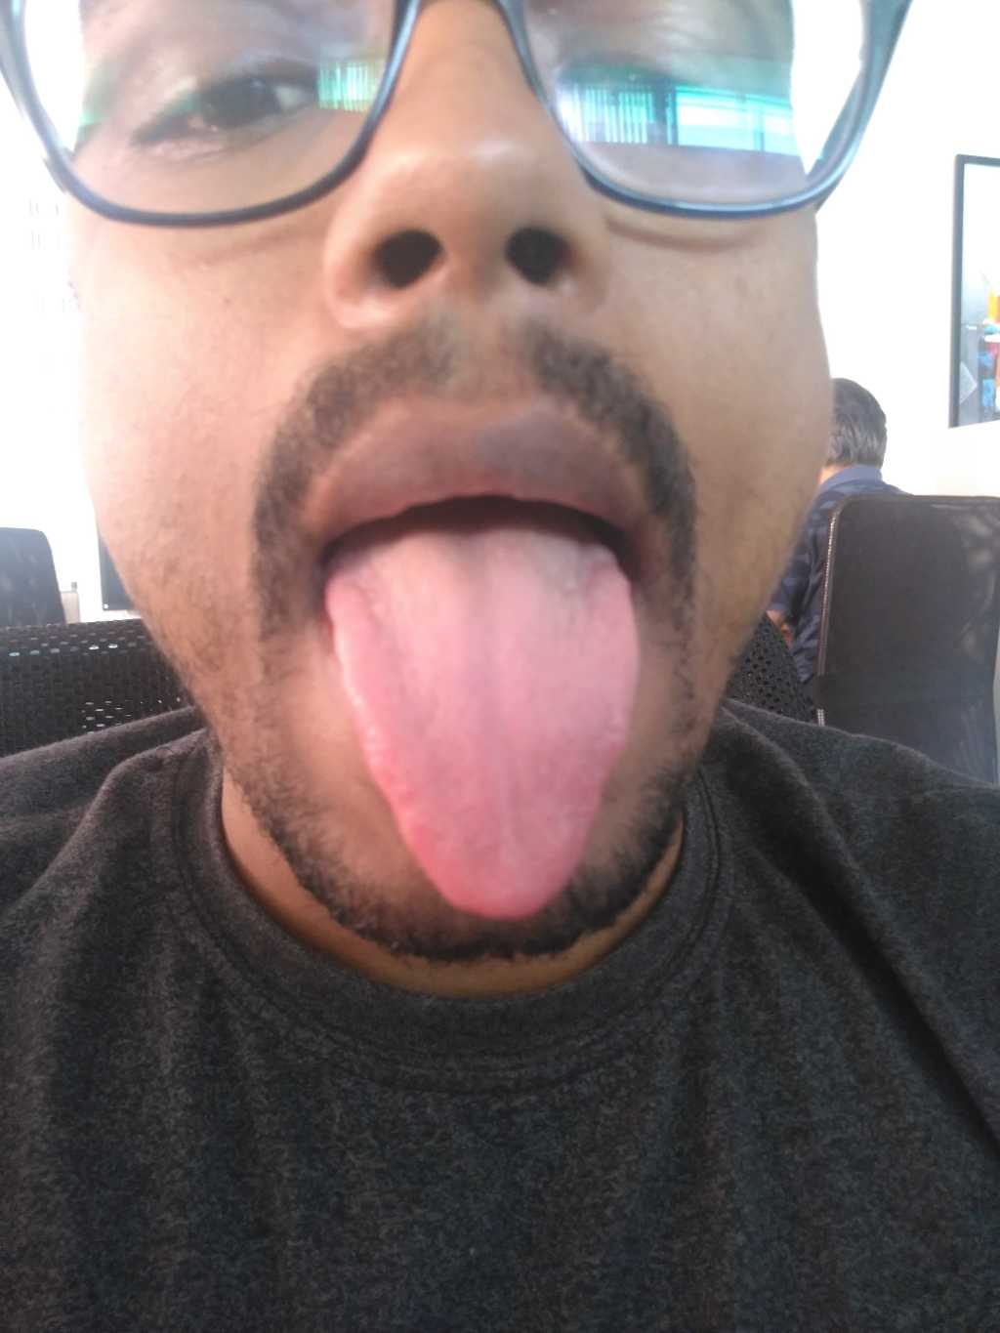
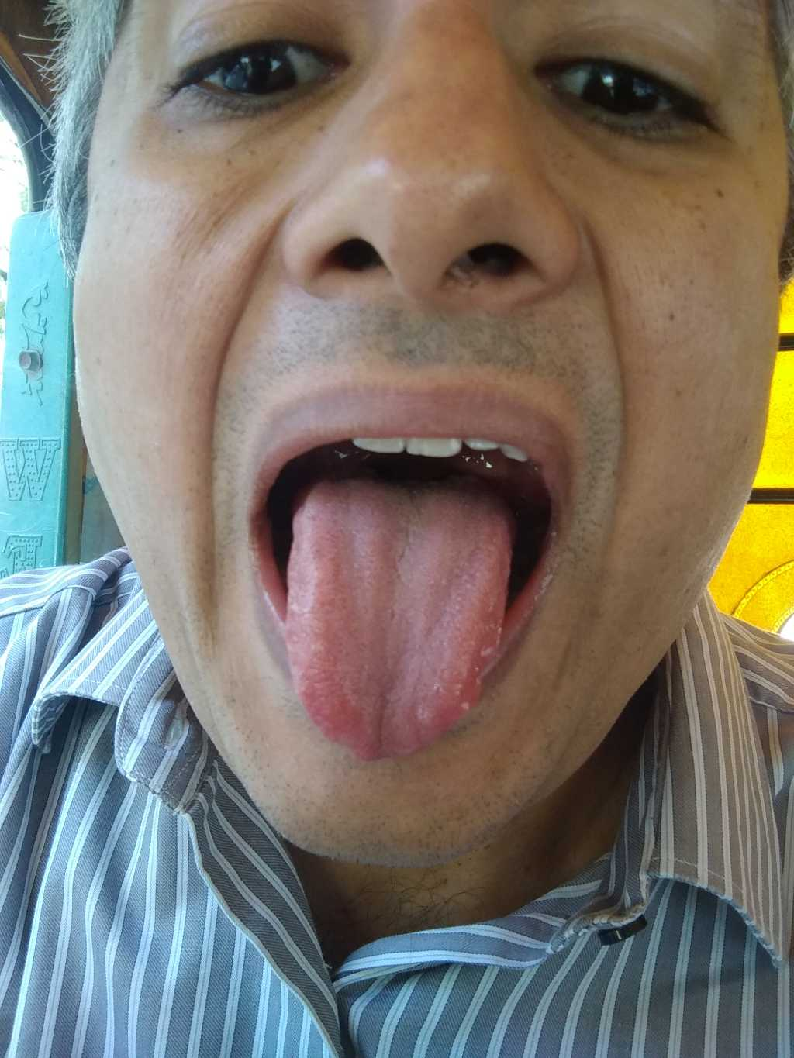
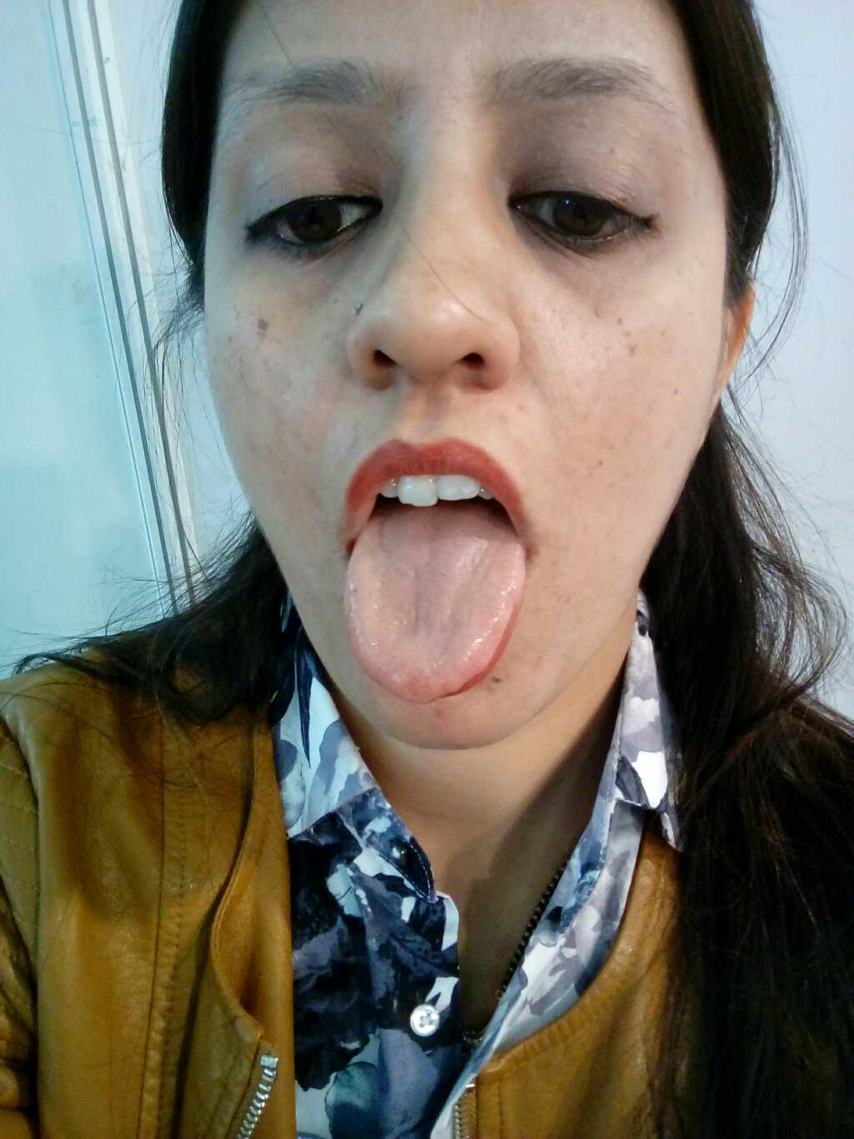
Data
Tongue bank of 100 images.
Splitting of images
We had 501 set of users of The Lola app, from whom we have randomly selected data.
Notes:
Insert 10 images

Slide 14
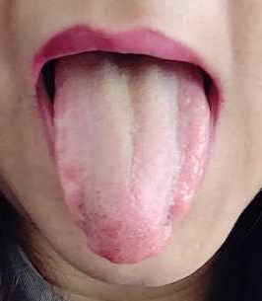
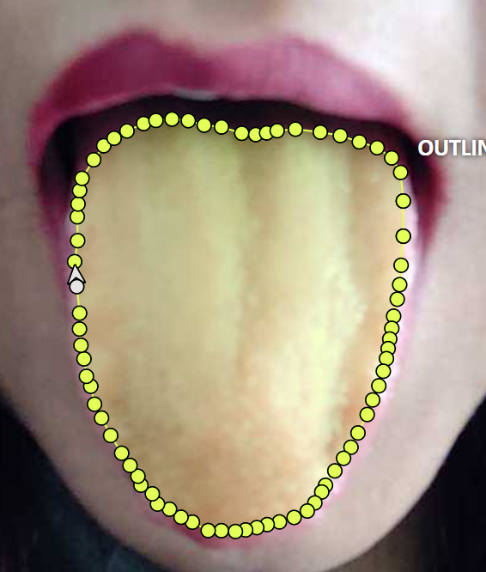
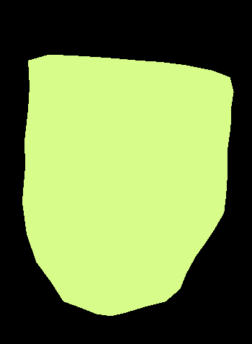
Pre-processing:
Original Image
Annotated image using Computer Vision Annotation Tool (CVAT)
Segmented image (silhouette) in the form of Common Objects in Context (COCO) dataset is obtained.
Notes:
Crop label

Slide 15
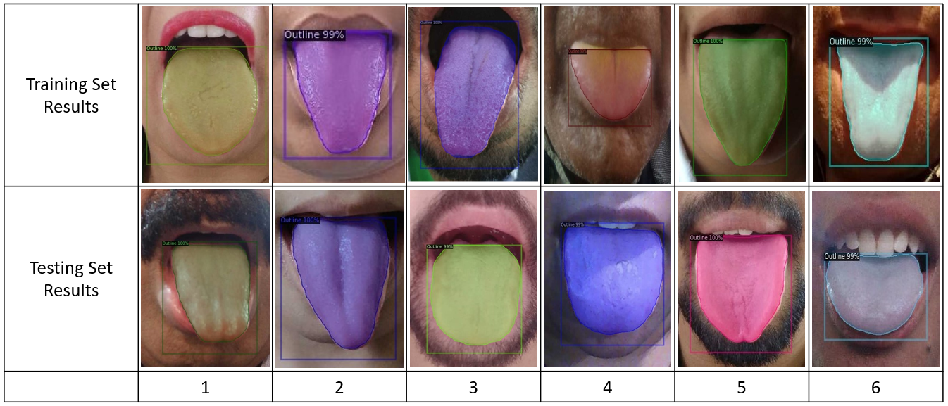
Result and discussion :
Visualization results (outline detection) of Detectron2 on different tongue data
We evaluated semantic segmentation metric which includes 1) Precision 2) Recall

Slide 16
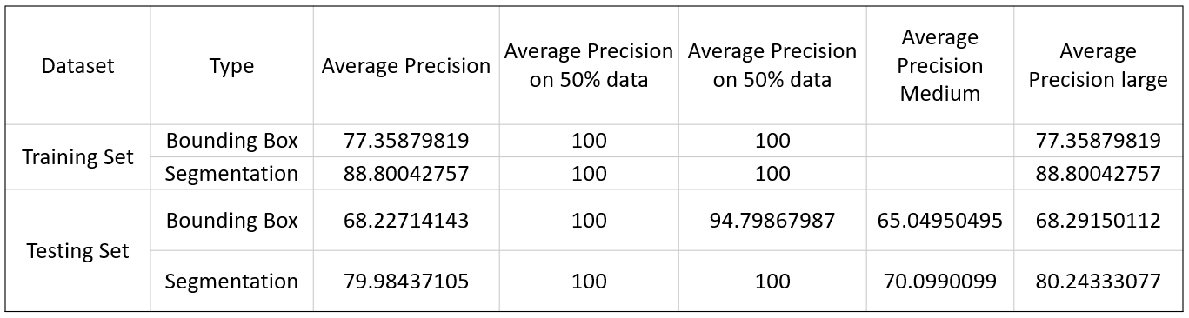
Segmentation metric:
Performance measures

Slide 17
Crack detection
Mention accuracy : 80 % accuracy is achieved to detect tongue outline and crack on tongue images.

Slide 18
Conclusion & Future scope
The most challenging problem in computer vision is object detection but with the introduction of neural networks and various advancements in deep learning the efficiency of object detection is increased.
Object detection is used extensively in medical imaging. Also in video surveillance, pedestrian detection, face detection.
In this project, we have studied and analysed object detection method like Detectron2 with Mask-RCNN. Testing is done on real time dataset of tongue images and results are shown.
In future, other methods can be used for object detection like U-Net architecture with addition of more classes dividing tongue in three parts such as crack front thin, crack middle thin, crack behind thin also by using different backbones to enhance performance.
Building personalised wellness tracker, Home-based, Non-invasive, wearable product.
Work on each part of tongue to reach respective body part diagnosis in order to work on wellbeing using TURYAA app.
Notes:
This has been used in live project. I am very happy that my work is accepted and is part of live project.

